Slide 1
If you'd like to work along with the demos, download the zip file found in the lab folder linked to on the course website for today

Slide 2
Large Scale Data Analysis for MSBA
Lecture06: Time Series in Pandas
Matthew Rupp

Slide 3
Today
A couple odds and ends
Time series analysis in Pandas
The different ways to measure time
Aggregating data using time
Basically: working with temporal data!
A couple more standard Pandas functions
query
where

Slide 4
Time series analysis in Pandas

Slide 5
Measuring time
I wish I could devote more time to time.
The measurement of time is actually quite complicated
Humanity has spent a lot of effort learning how to measure it.
It's not just an academic exercise; people have been studying it to solve problems that have a complexity that tracks with that of human advancement.
Philosophically it's difficult for something so common to us all
Ever fall into a blackhole?

Slide 6
Did you know a second is...
the duration of 9,192,631,770 periods of the radiation corresponding to the transition between the two hyperfine levels of the ground state of the caesium-133 atom.
Now, we don't normally think of time this way. But we keep trying to get more accurate with calculating time. At a certain point it becomes strange: for example, time moves slower at the equator than the poles due to relativity.
More pragmatically: the earth doesn't go around the sun exactly the same length of time every year, so we have to incorporate corrections if we want to keep our clocks "exactly" calibrated with the solar year.

Slide 7
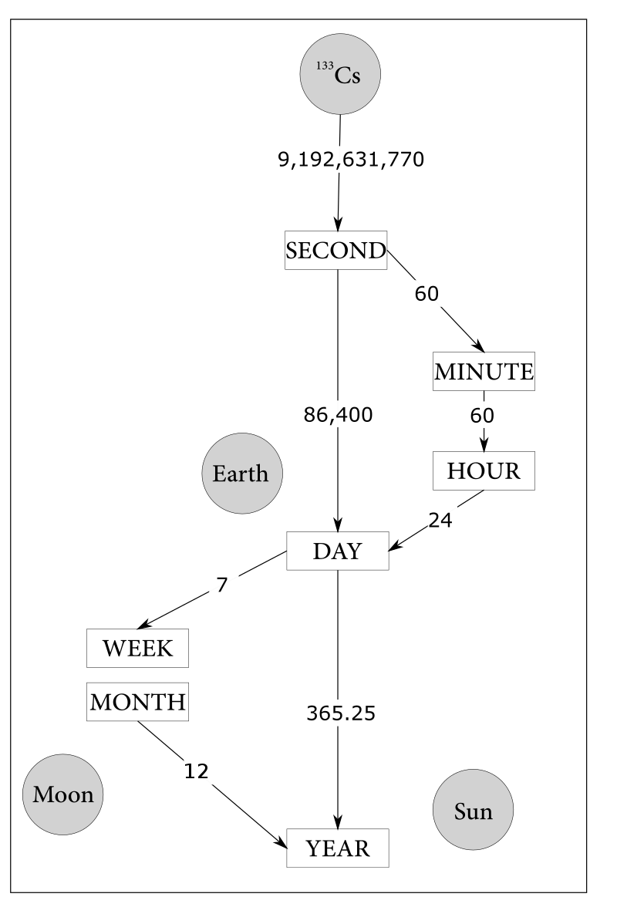
Time is messy

Slide 8
Let Pandas simplify dealing with time
Three different types of time in Pandas (and Python in general)
Time stamps
The simplest; when did something happen?
Time intervals and periods
Time between measurements relative to particular reference(s)
Time deltas or durations
Measurements between two time points
Pandas hides the complexity of dealing with these three different types of time by providing data structures to simplify the process of working with time series. The user can then concentrate on the question rather than manually manipulating temporal data to adjust it to answer a particular question.

Slide 9
Time stamps
Give us an instance of time.
The package datetime provides us with the basic Python utilities to handle date and time measurements.
date gives us calendar date
time gives us hours, minutes, seconds, and microseconds
datetime gives us both
timedelta gives us a duration between two datetime values
tzinfo gives us timezone information
The package dateutil gives us a flexible parser.
Pandas combines all of this and more to provide flexible handling of dates and times.

Slide 10
What time is it?
There are many ways to measure time. There are two types of timestamps you should be aware of.
UTC (Universal Time Coordinated). A timezone-free measure of time.
Getting rid of time zones helps; the computer can add them back in later.
No, we're not done "coordinating" it; the Earth doesn't go around the sun exactly the same every year.
Unix Time - the number of seconds since January 1, 1970.
Unix time is used as a means of time stamping, and the results are then mapped into something human-like.
Y2k38

Slide 11
Demo datetime, dateutil

Slide 12
Pandas Data Structures
Series (with a single dtype)
Labeled index
colA
colB
colC
colD
Column labels (df.columns)
0
4
3.14
'A'
True
1
5
1.50
'A'
True
2
8
2.00
'M'
True
3
3
5.78
'N'
NaN
Series documentation
DataFrame documentation
4
2
0.20
'K'
False
5
2
5.30
'K'
True
6
NaN
0.0
'R'
False
DataFrame

Slide 13
DatetimeIndex
Pandas provides a number of ways to index (select) data by time.
DatetimeIndex is one way
It's the most generic way to handle time data
It's based on datetime but extended
You can convert indexes or Series into it
read_csv has an option of telling Pandas to try to convert a data Series to it.
Panda's date_range is another way of generating a range of one

Slide 14
Demo Pandas datetime

Slide 15
Time intervals and periods
Time stamps are fine and good
But don't you want data on a regular interval rather than an irregular one?
For example, do you care at which hour a particular measurement was made if you are looking at monthly or quarterly reporting?
We can convert DatetimeIndex into a PeriodIndex to "simplify" our times
Regular intervals
There are a whole lot of different interval frequencies Pandas recognizes
We can also resample our data (up or downsampling) to coax it into a regular period-based format

Slide 16
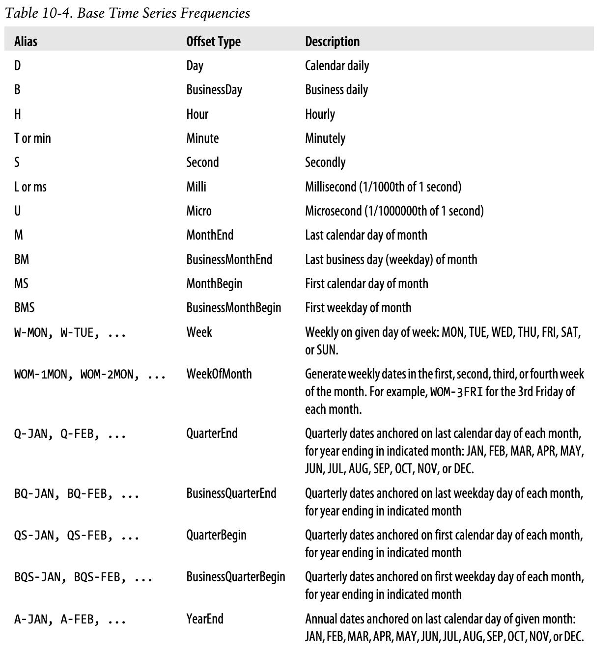
Time series base frequencies
From Python for Data Analysis, Wes McKinney 2018.

Slide 17
Frequencies and offsets
Using our base frequencies, we can generate regular dates and times.
We can also use these base frequencies to generate offsets using basic math
These are things like adding an hour, week, or quarter to a timestamp.
We can also subtract timestamps to get timedeltas
The module dateutil also has a relativedelta class that can handle the drudgery of more complicated time delta calculations (e.g. it handles leap years, month differences, etc.)

Slide 18
PeriodIndex
We can convert Timestamps into Periods and back again
This is useful if we want to look at the data in different ways
The to_period() will convert a timestamp series into Periods
The to_timestamp() will a series of Period entries into Timestamps
We can also create a PeriodIndex directly from its constructor.

Slide 19
Resampling
Sometimes the frequency of our data isn't the way we want it
We can change that by resampling our time series
down-sampling aggregates data into longer periods of time
up-sampling tries to create a dataview with a greater frequency
From the docs:
"resample() is a time-based groupby, followed by a reduction method on each of its groups"

Slide 20
Demo Pandas periods

Slide 21
Windowing
Often we're not interested in an instantaneous measurement for analysis
Instead we're interested in measurements over a span of time
Windowing lets us slide a "window" over our time data to see how it aggregates as time progresses
Think of it as a temporal groupby

Slide 22
Demo Pandas windows

Slide 23
Lab06
You will likely have to read the documentation, Google around for solutions, and generally "play" with the data to solve the problems in the exercise.
This is normal! And there are many ways to solve the problems, some more efficient than others. Again, this is normal!
We want the correct answer, not an optimal method for now.

